Slide 2
these are the most important goals that the state intends to achieve

Slide 3
Article 1
Italy is a republic founded
on work

Slide 4
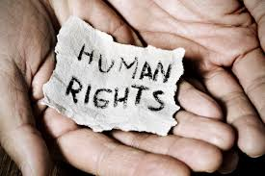
Article 2
Italy recognizes fundamental human rights

Slide 5
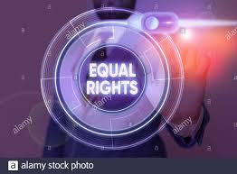
Article 3
All citizens are equal before the law.

Slide 6
ARTICLE 4
All citizens have the right to work

Slide 7
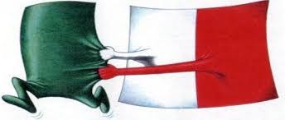
ARTICLE 5
Italy is one, it is and indivisible

Slide 8
ARTICLE 6
Italy protects linguistic minorities

Slide 9
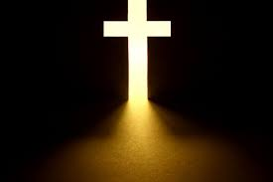
ARTICLE 7
The Italian state and the Catholic Church are independent and sovereign

Slide 10
Article 8
All religious
confessions are free

Slide 11
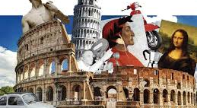
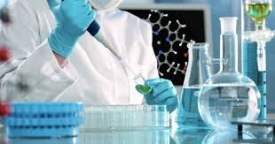
ARTICLE 9
italy promotes culture
and scientific research

Slide 12
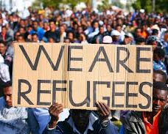
ARTICLE 10
Does italy recognize the right of asylum for foreigns

Slide 13
ARTICLE 11
Italy repudiates war as an instrument of offense

Slide 14
ARTICLE 12
the Italian flag is the tricolor: Green, white and red

Slide 15
THE END
Gabriele Barnaba;
Giuseppe Comes;
Mauro Marzolla;
Eligio Svezia

