Slide 1
Erasmus+
1st activity
The world as the most beautiful
gift that man has received“
Germany

Slide 2
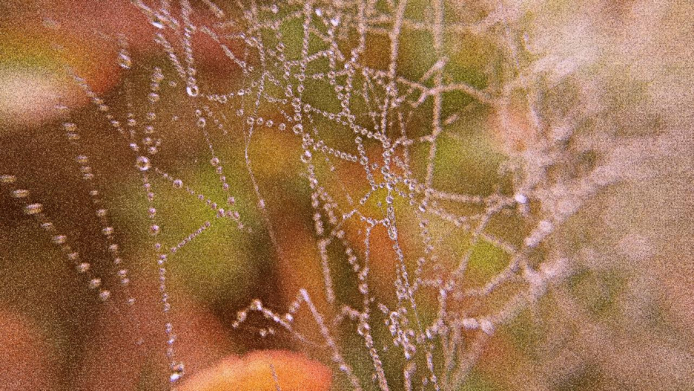
This picture was taken in the morning in our garden. Every single dewdrop sparkles magically on the spider's web in the morning sun and reflects a very individual image of its surroundings. (Hannah E.)

Slide 3
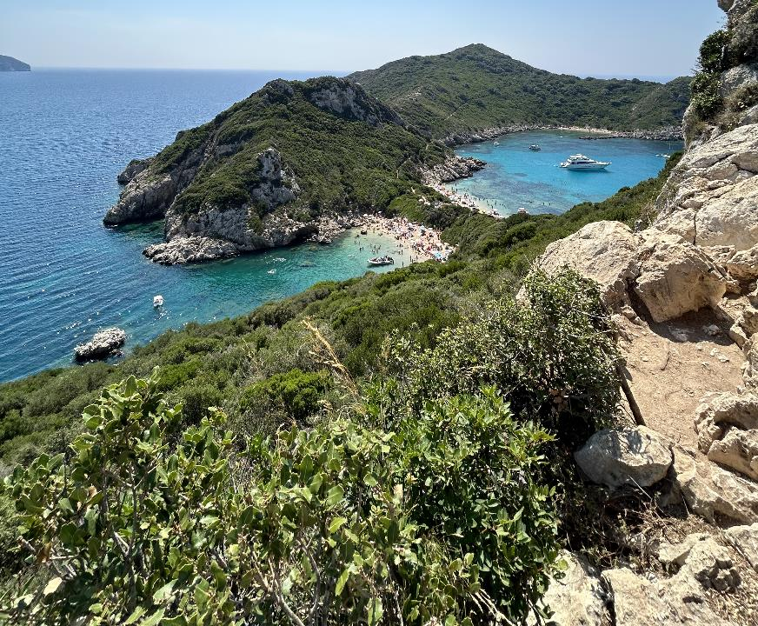

The picture was taken this year on holiday in Corfu. We hiked for 30 minutes, at 34 degrees, along a very strenuous path with an extremely high number of stones and inclines, to finally see this view. The path almost brought me to my limits, but this view compensated for everything and fascinated me. There was something amazing about the clear colours and their combination with each other. (Jana H.)

Slide 4
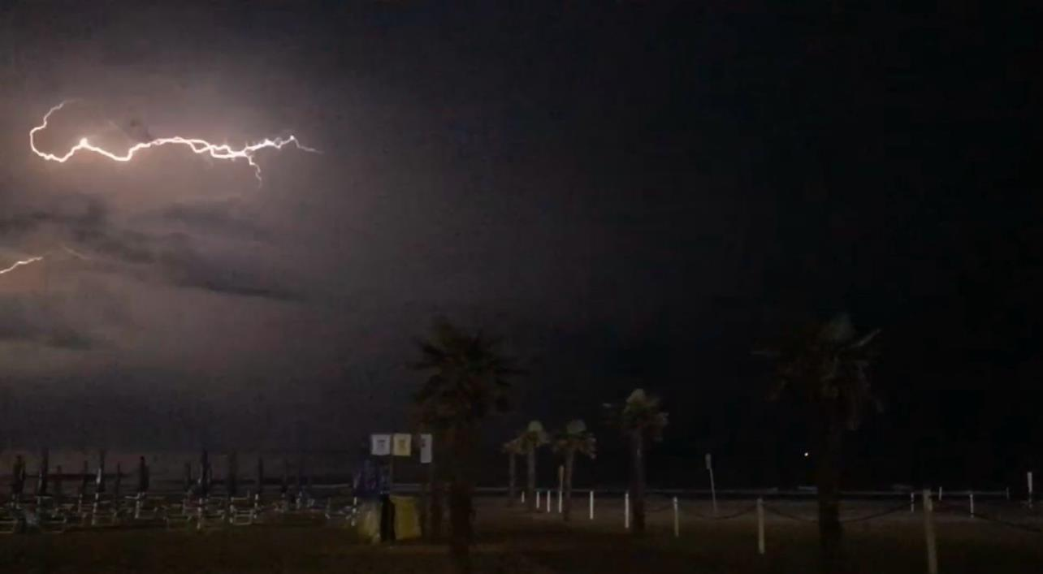
I am quite a fan of the thunderstorm and then this picture was taken. Not only watching a thunderstorm and experiencing this force of nature was fascinating, but in this particular case also seeing the lightning strike the sea impressed me. (Lea C.)

Slide 5
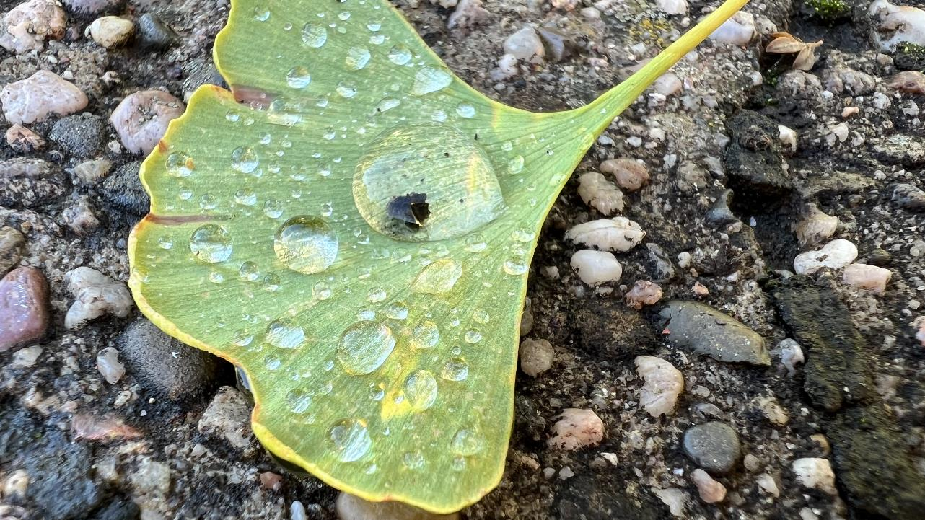
The ginkgo leaf stands for hope. For me it has a great meaning because it reminds me of my great-grandparents, whom I miss very much. A ginkgo leaf adorns their gravestone. When I saw it, I had to stop and hold it. (Leonie S.)

