Slide 1
Beauty enchanted in four elements
Erasmus+ Poland

Slide 2
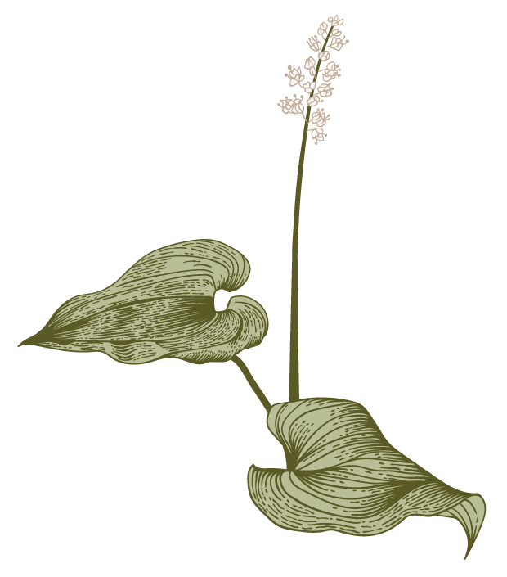

Presentation
E
Our group has prepared
an exhibition of photos they have taken. We also organised
a contest to choose the best four photos an d descritions.

Slide 3
Photos of Nature
Presentation of students’ works

Slide 4
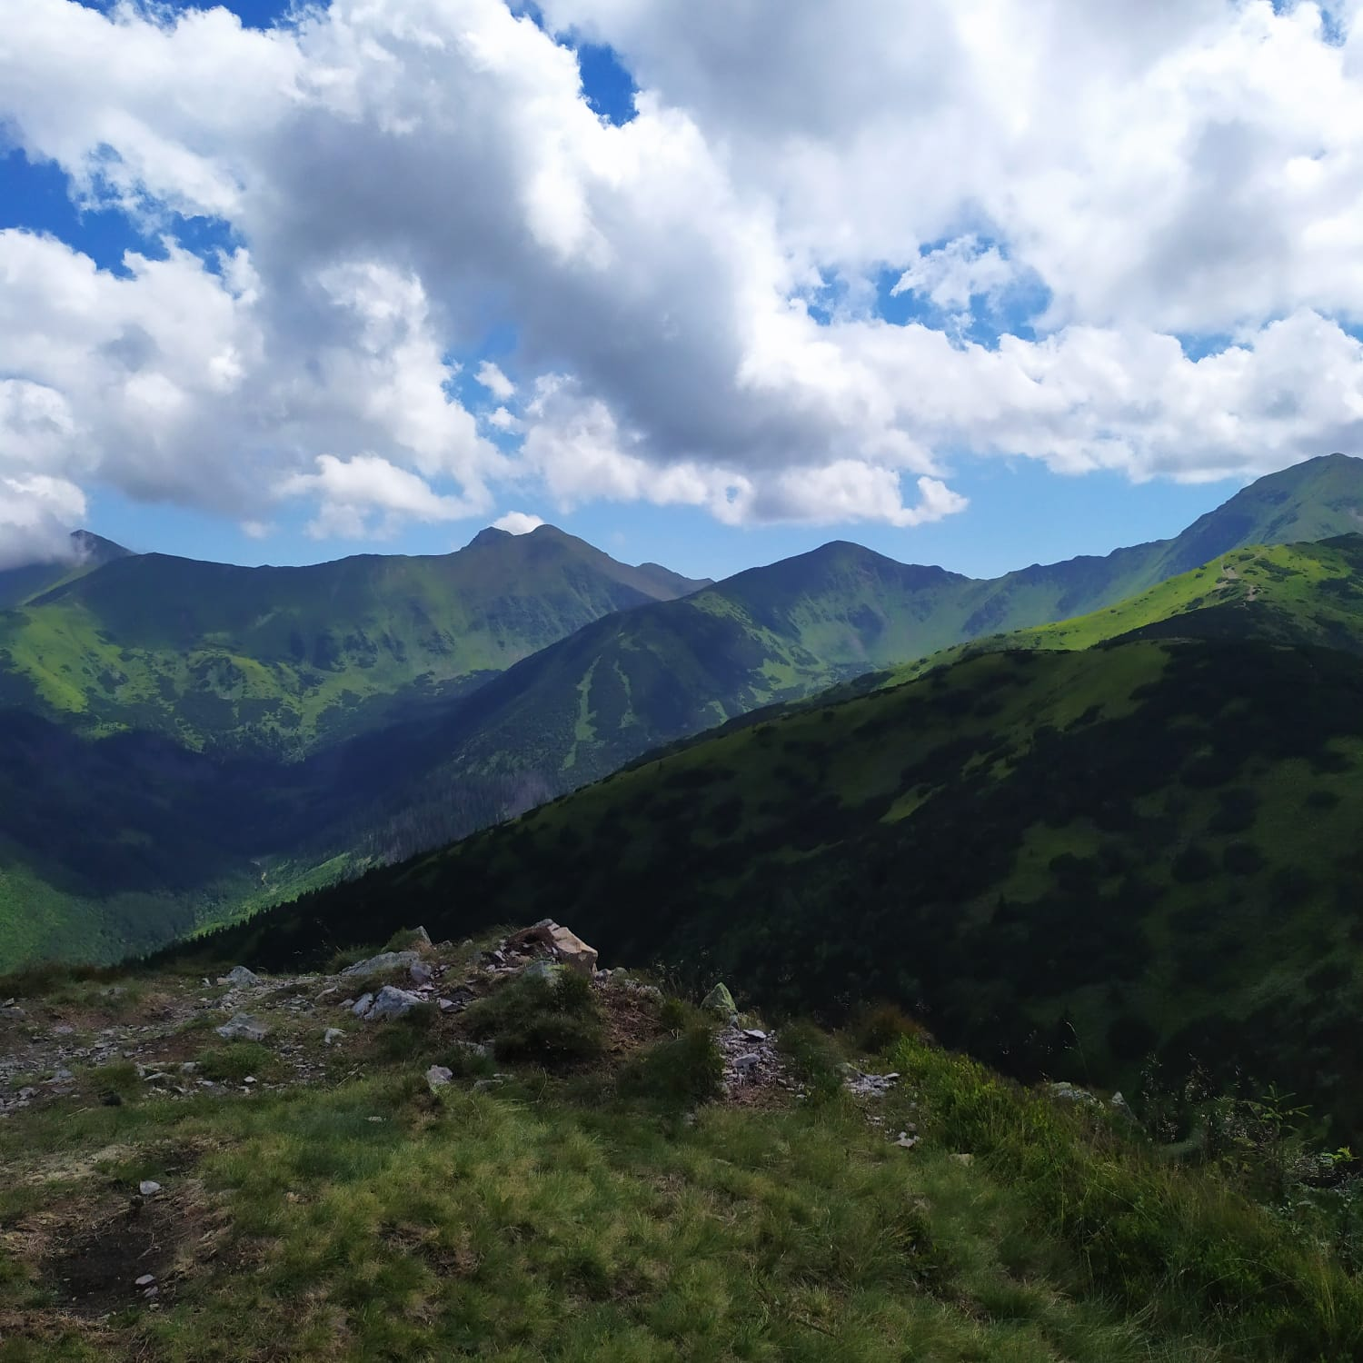
Photo no 1
The photo shows the Tatra Mountains visible from the top of Grześ.
The earth element captured in the photo captivated me with its beauty, size and stability.
People often think they are invincible, but when they go to the mountains they experience how small they are. While walking along the paths leading to the peak, you have time to think during physical activity and take a break from the noise of everyday life.
The Earth is always there even when everything else disappears.
Place : Tatry, Grześ
Author: Weronika Wielicka

Slide 5
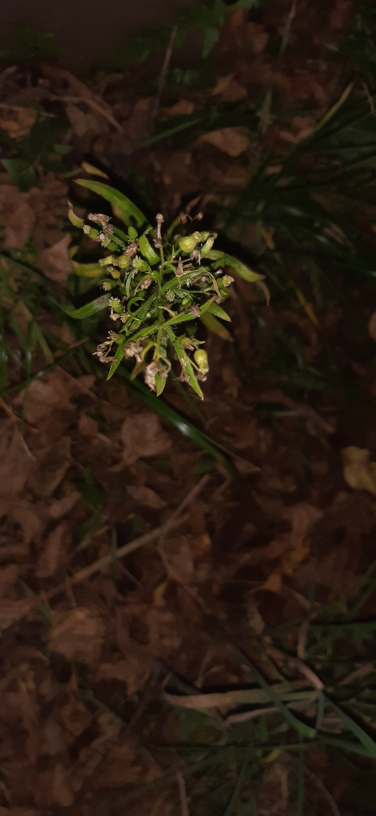
Photo no 2
“Awakening”
The picture represents a small green plant growing amongst dead,dry leaves in a park near one of the main roads in Będzin. It represents the earth element. The picture really said something to me cause in some way it represented our minds. It represents our memories, a lot of them are very vague and hard to remember, but some of them just stick with us forever, till the end of our life.
Author Mateusz Jęczmyk

Slide 6
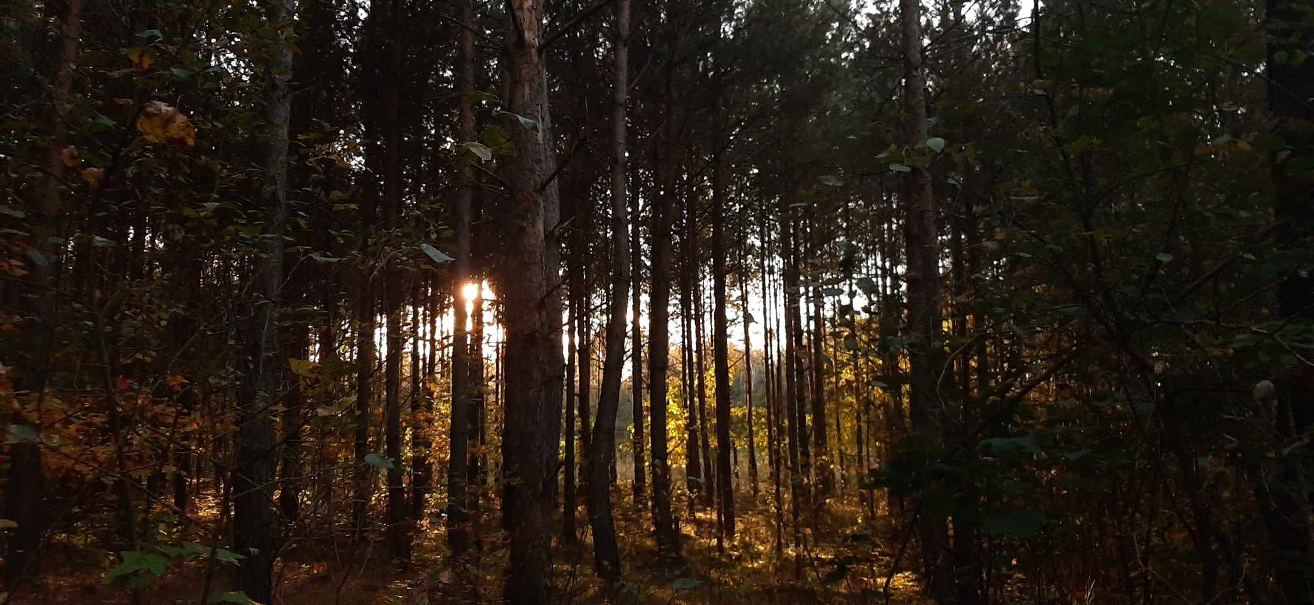
Photo no 3

Slide 7
Photo no 3
The photo is a forest during an early autumn walk. In my eyes, it represents the power of mother earth who feeds her children during spring and summer, and now she is a little tired and needs to start resting, which is a beautiful phenomenon for us humans.
Mother Earth begins to rest and feeds humanity with the fruits of the activity of the forest floor and in her rest she takes away the splendor of the trees, feeds people's eyes with colors and the last rays of the sun allow us to see the beauty of the crowns and trunks of trees which will soon fall asleep and in the spring thanks to the creative power of the Earth they will wake up, but now they show their best sides.
This view captivated me with the peace expressed in natural colors and chiaroscuro. My emotion is admiration because the Earth, even though it begins to rest in the fall, will still return to hard work in the spring in full strength so that ordinary people can reap the benefits from it (material, e.g. in agriculture and non-material beauty for the eye) all year round.
Author: Klaudia Ściskłała

Slide 8
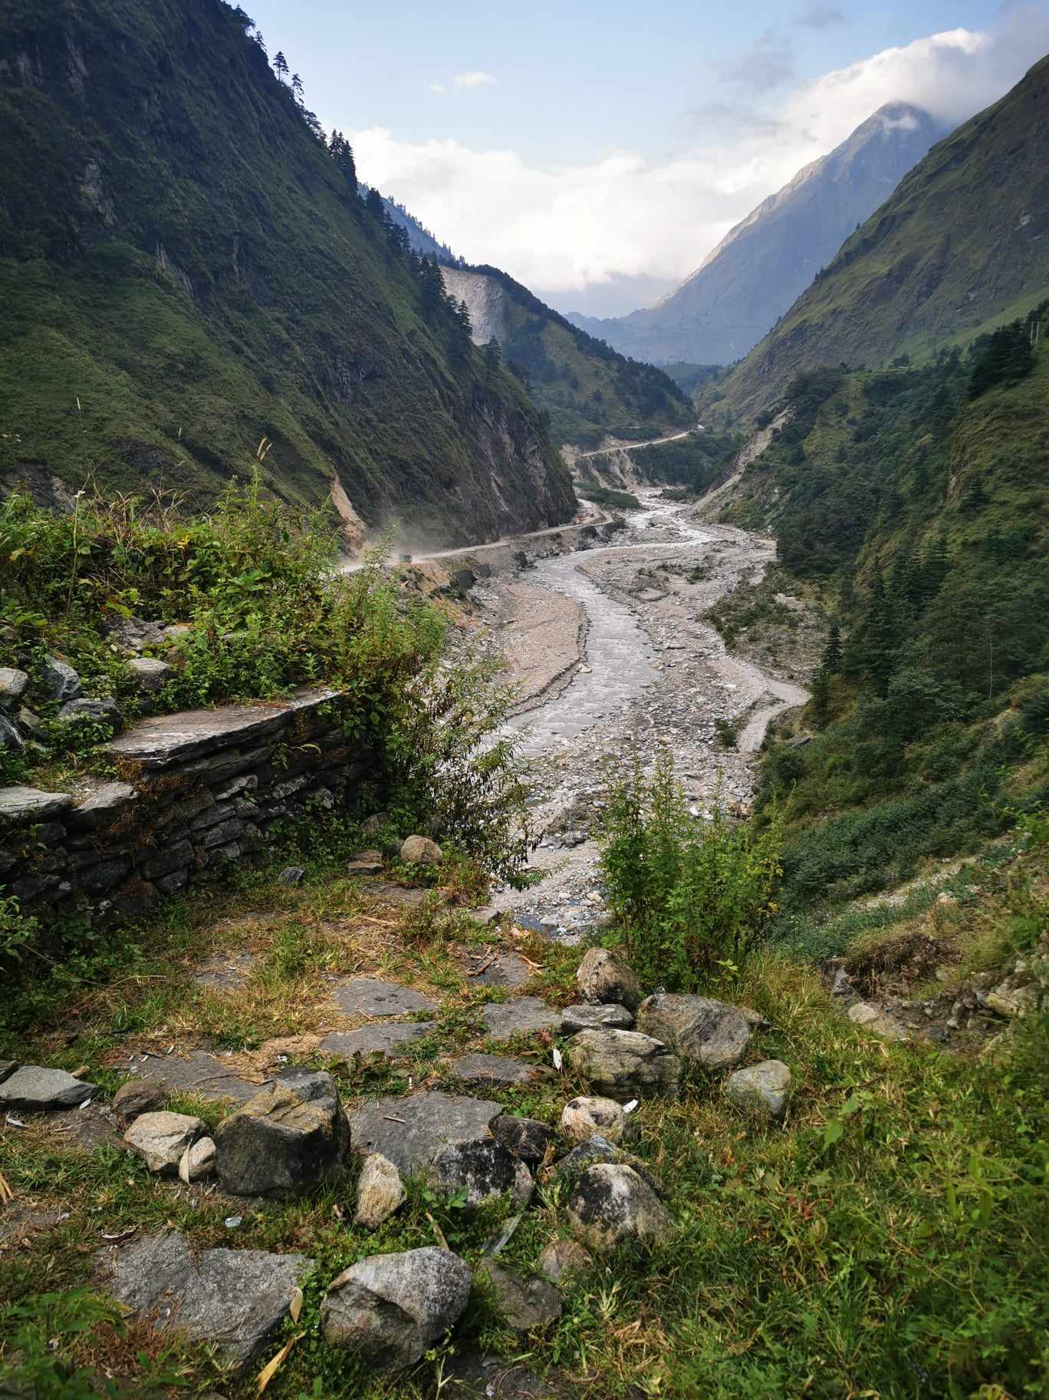
Photo no 4
Nestled in Nepal's untouched valleys, the earth unveils its raw magnificence. Mountains, draped in verdant cloaks, stand as sentinels over a tranquil riverbed, each stone and pebble a testament to nature's intricate craftsmanship. The soil, a rich tapestry of moss and age-old rocks, exudes an aura of grounding and connection. Every nook and cranny in this landscape resonates with the deep, enduring essence of the earth, inviting all to marvel at its timeless beauty and strength.
Author Franciszek Kruczek

Slide 9
Thank you
Erasmus +
Ewa Król
Natalia Latosińska
Patrycja Skrzypczyk
Grzegorz Gwóźdź
Michał Witkowski
Activity 1
„The world as the most beautiful gift that man has received”

