Slide 1
Students were asked to take a photo that would represent the natural scenario of their region
Aveiro is a region characterized by the mixture of water and land
So, their photos represent this view of their region

Slide 2
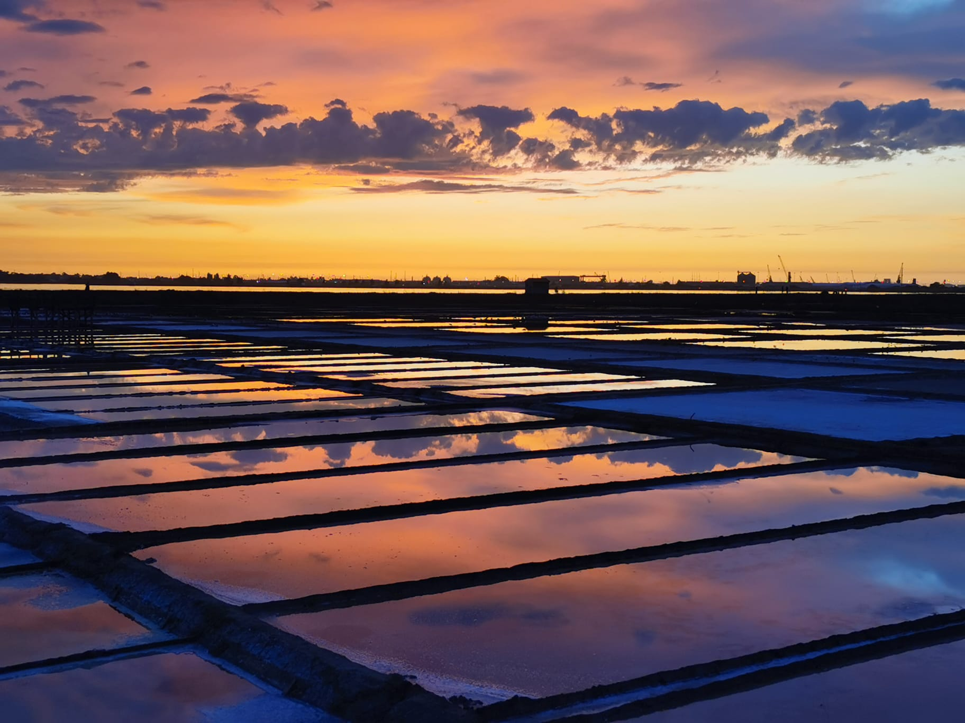
The saltpans in Aveiro at the sunset
Photo by Margarida F.

Slide 3
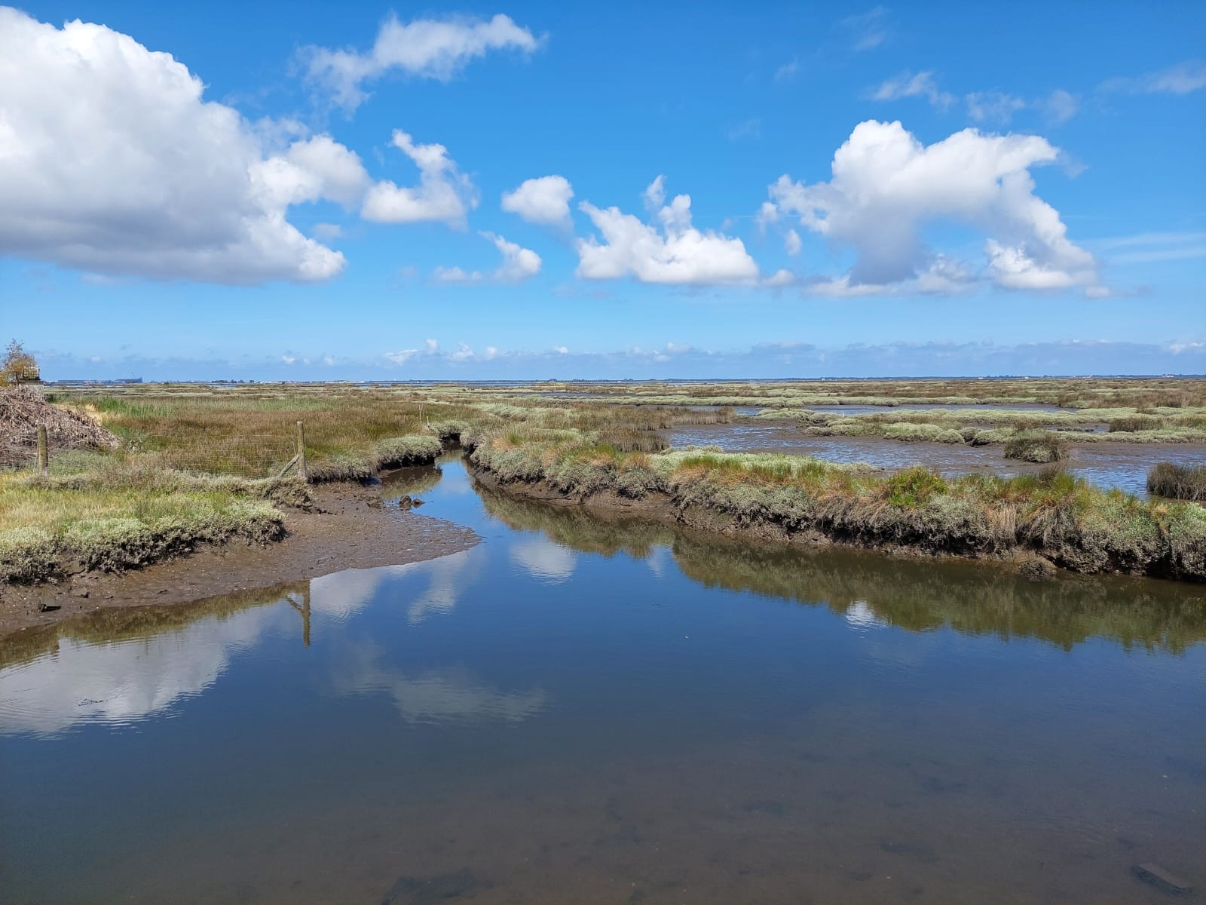
The marshes in the region of Aveiro
Photo by Joana D.

Slide 4
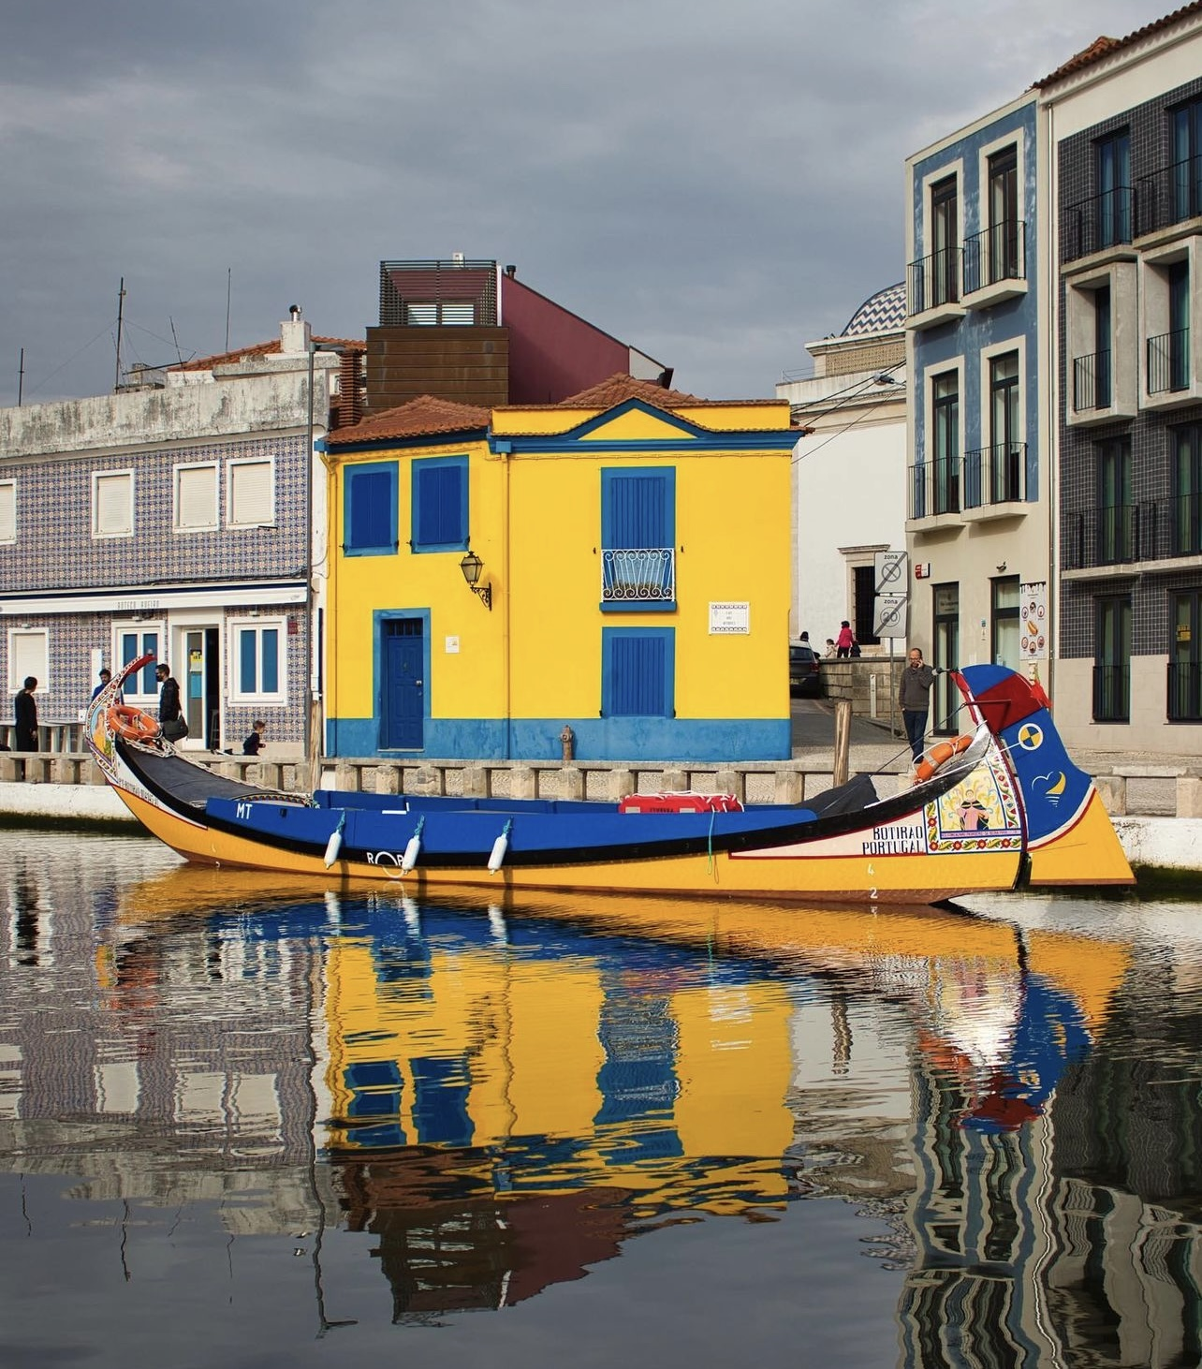
Moliceiro boat in the Ria canals in the city centre
Photo by Diana P.

Slide 5
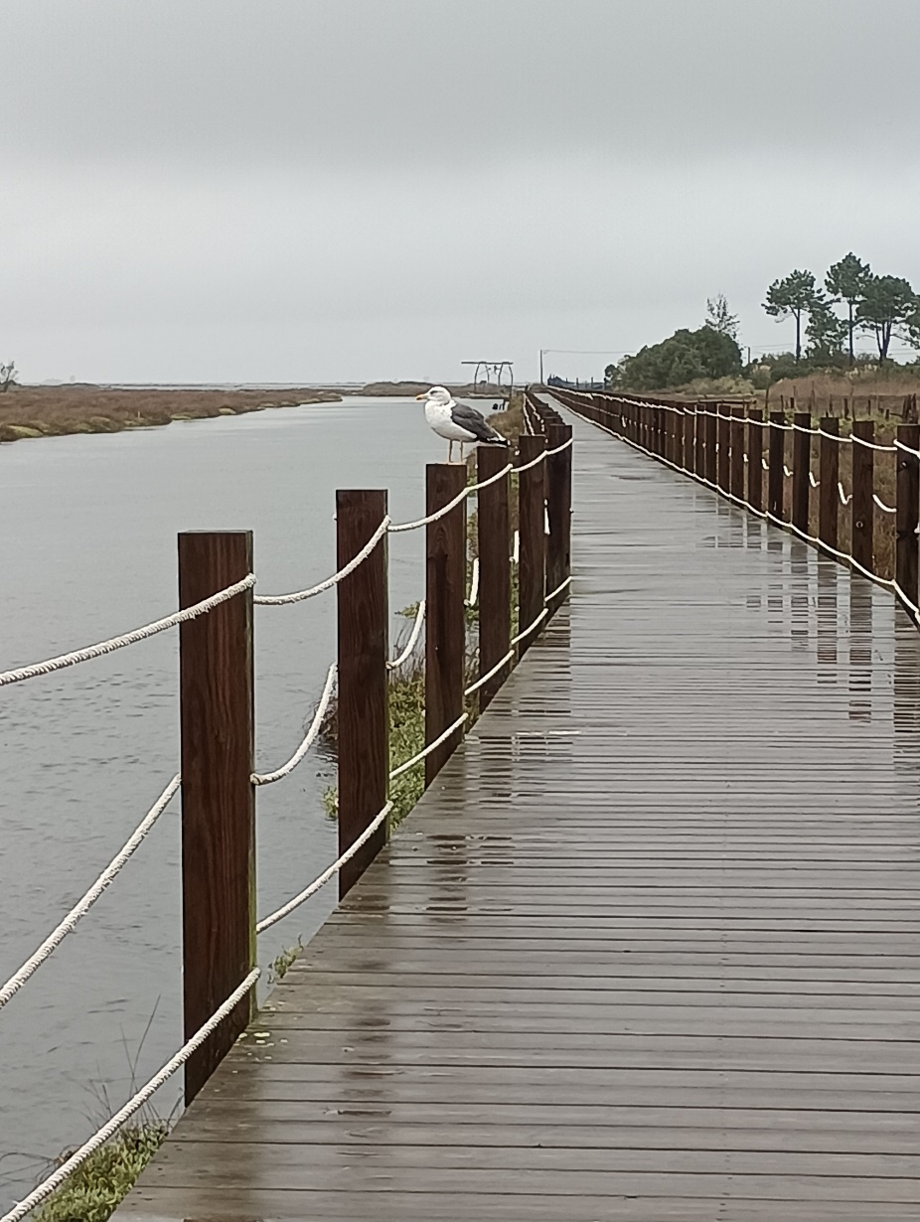
A seagull watching the horizon
Photo by Benjamim V.

